Slide 1

Brave New World
BY ALDOUS HUXLEY
Introduction
and Historical Context

Slide 2
“...most men and women will grow up to love their servitude and will never dream of revolution.”
- ALDOUS HUXLEY

Slide 3

Fact Sheet: Brave New World
Author: Aldous Huxley
Date of publication: 1932
Country of origin: England
Genre: speculative fiction, dystopian novel
Point of view: third-person omniscient
Setting: England in the year 2540

Slide 4
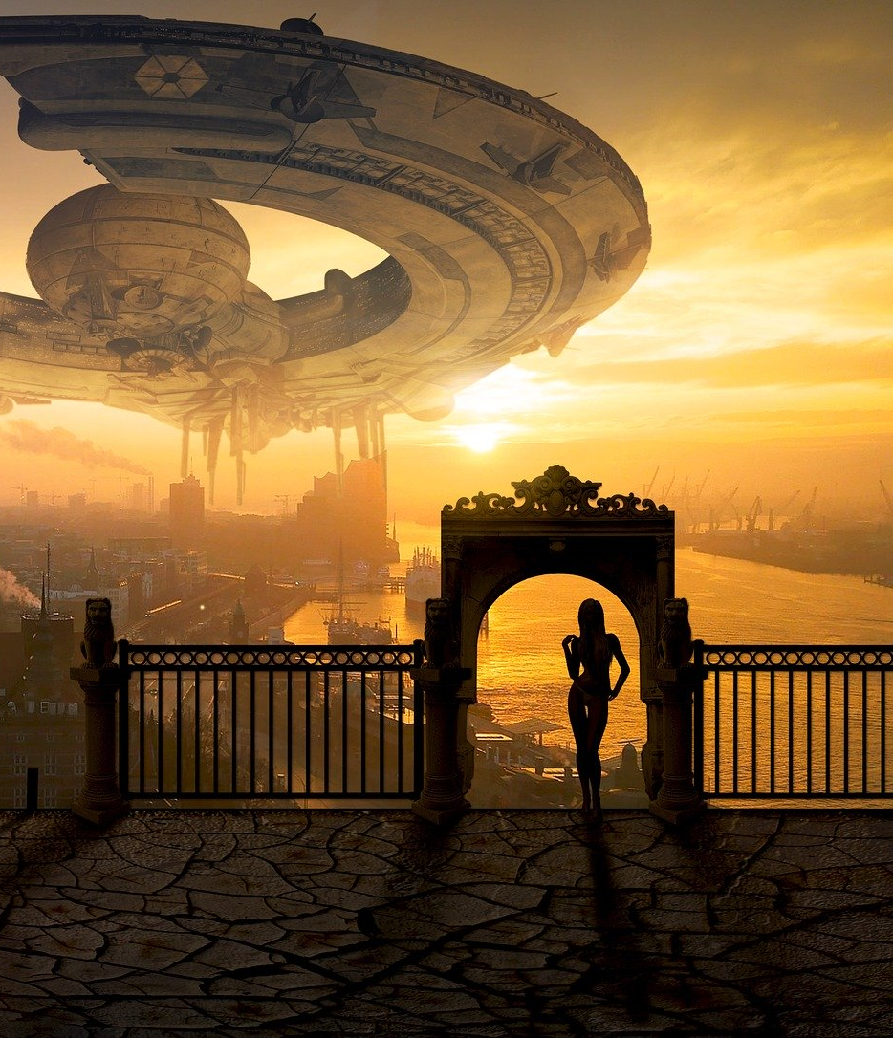
Speculative Fiction
The term speculative fiction has two competing definitions:
A super-genre that includes science fiction, fantasy, supernatural fiction, alternate histories, dystopian fiction, and even superhero fiction.
A genre akin to science fiction but focusing on the human condition and societal development rather than science and technology (i.e., imagined utopias and dystopias).

Slide 5
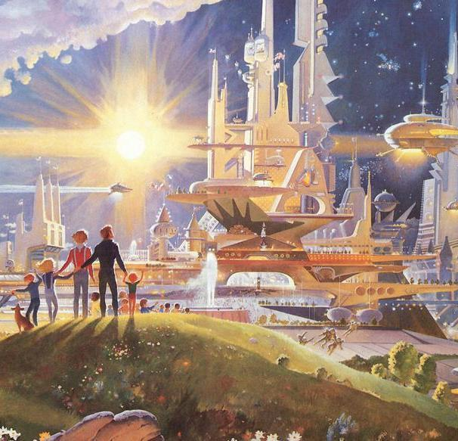
The Concept of Utopia
The perfect human society
"Utopia," from the Greek for "no place.”
Sir Thomas More's work Utopia (1516)
More coined the term.
He used a fictional society to explore the problems in his own society.
Many thinkers explored the concept before More coined the term.
The most famous utopian writer of Huxley’s time was H.G. Wells, who wrote A Modern Utopia in 1905.

Slide 6
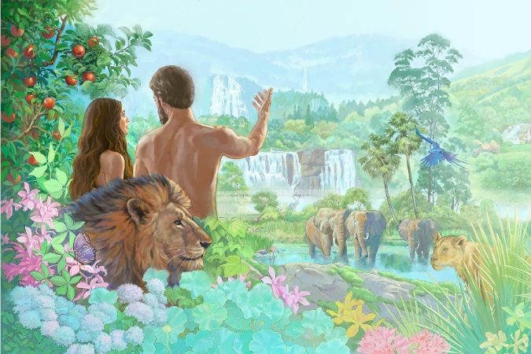

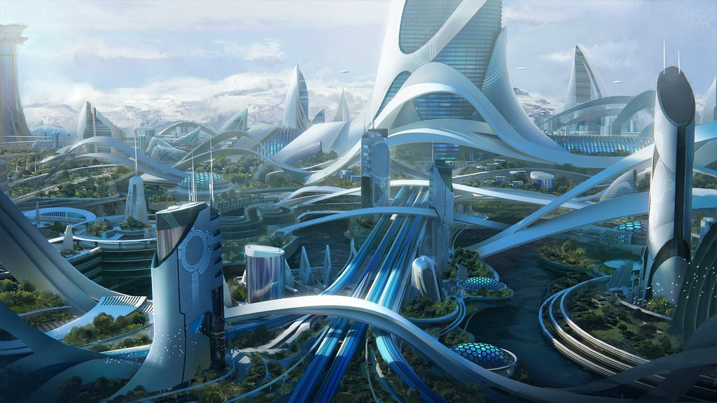
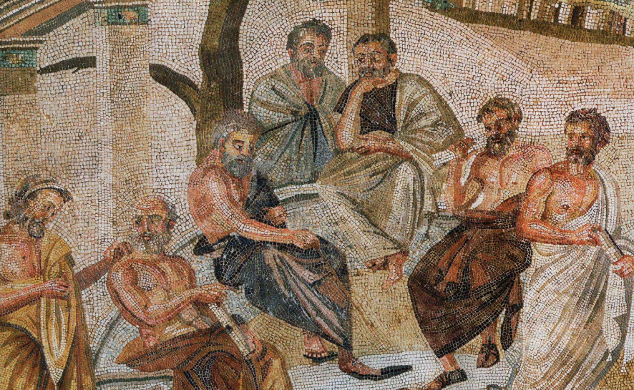
Imagined Utopias
Moral
Social
Political
Ecological
Economic
Religious
Technological
Feminist

Slide 7
Imagined Utopias
The Republic (~380 BCE) by Plato – the perfect Greek city-state
Tao Hua Yuan (421 CE) by Tao Yuanming – intellectuals living in harmony with nature
Al-Madina al-Fadila (~950 CE) by Al-Farabi – life in Medina as perfected under the rule of the prophet Mohamed
New Atlantis (1627) by Francis Bacon – a futuristic society based on "generosity and enlightenment, dignity and splendor, piety and public spirit"
Gloriana , or the Revolution of 1900 (1890) by Lady Florence Dixie – British society perfected through feminism
Walden Two (1948) by B. F. Skinner – a small, self-sufficient utopia based on social science

Slide 8
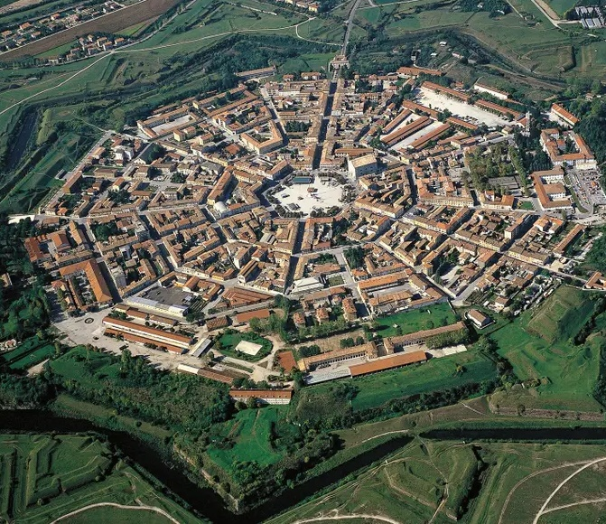
Real Attempts at Utopia
Palmanova, 1593 - the perfect fortress city (Venetian Republic)
New Lanark, 1786 - a socialist manufacturing center (Scotland)
Home, 1895 - nudism and anarchy (Washington State)
Penudo, 1933 – communal agriculture (Brazil)
“The happy colonists are vegetarians and teetotalers...who help one another to build houses and to settle on their own little estates, sell the collected fruits and share the proceeds. They can live without too much toil, and thus have leisure for study, games and hobbies.” (Caines)

Slide 9

Utopia and dystopia
Aldous Huxley worried that optimistic visions of perfect societies were wrong-headed and even dangerous.
Dystopian novels imagine that “progress” might have terrible results. In other words, striving for utopia might result in horrific dystopia.
Dystopia: an imagined state or society in which there is great suffering or injustice, typically one that is totalitarian or post-apocalyptic. (Merriam-Webster)

Slide 10








Dystopian Novels

Slide 11

Welcome to Brave New World
The year is 632 AF (2540 to you and me).
There is no war; England and the rest of the world are unified under the control of The World State.
You live a carefree life. Technological conveniences abound. You do not worry about physical needs, getting old, dating, family life, or personal goals.
Your job is easy, and you enjoy it. It is what you were born to do.
Your free time is full of titillating amusements that leave no time for depressing philosophical questions.
Sounds pretty good, right?

Slide 12
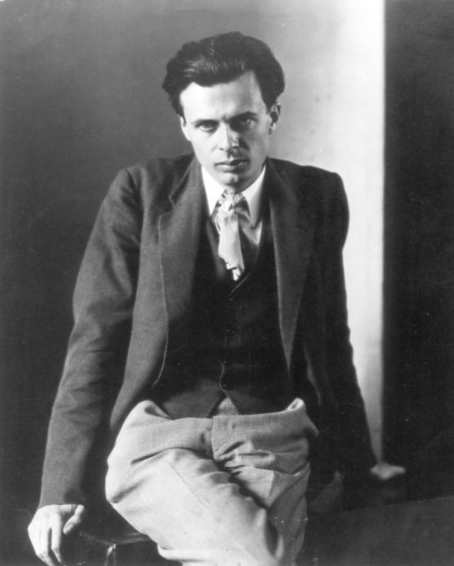
The Author: Aldous Huxley
Born in Godalming, England in 1894
Childhood nickname: “Ogre”
A family of scientists and writers
Mother died when he was 14
Blind for almost three years as a young man
Completed first novel at age 17
“Incompetent” French teacher for 1 year
Rejected from service in WWI due to poor eyesight
Worked in a chemical plant and as a farm laborer
First published novel at age 27
Moved to Los Angeles in 1937
Nominated for the Nobel Prize in Literature 7 times

Slide 13
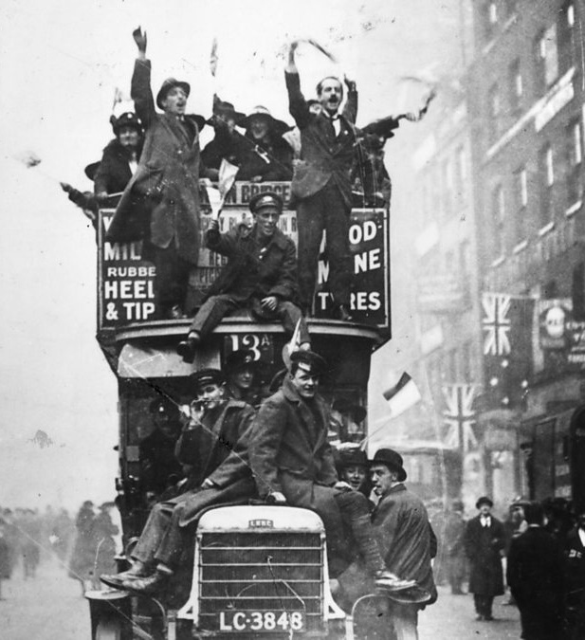
Historical context
Huxley worried that people were becoming too optimistic about “progress.”
Developments in Psychology
Technology and Industry
Genetics and Eugenics
Entertainment / Media
Social Change
Government and World Order
Shattered Optimism
“…between World War I and World War II, the height of an era of technological optimism in the West.” (Lohnes)

Slide 14
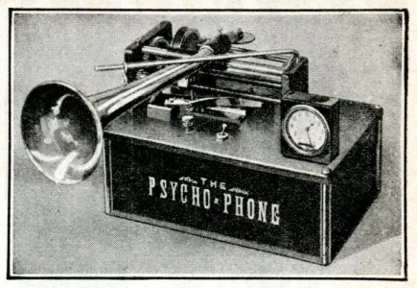
Developments in Psychology
1879 – The world’s first psychology lab opens in Germany.
1897 – Ivan Pavlov publishes his work on the classical conditioning of dogs.
1901 – Sigmund Freud publishes The Psychopathology of Everyday Life.
1927 - Alois Saliger invents the Psycho-Phone for sleep learning.
1928 – John B. Watson publishes Psychological Care of Infant and Child.

Slide 15
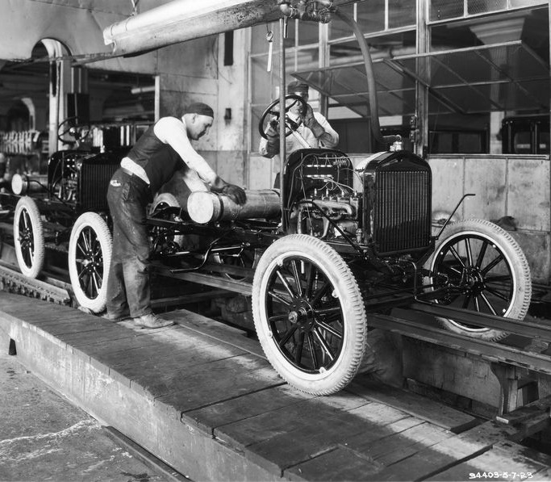
Technology and Industry
Prior to the Great Depression, “The Roaring 20s” marked an increase in the standard of living and consumerism.
This was largely the result of technological advancement and the rise of assembly line manufacturing.
On trend:
Zippers (controversial)
Chewing gum
The autogiro (early helicopter)
Ford automobiles

Slide 16
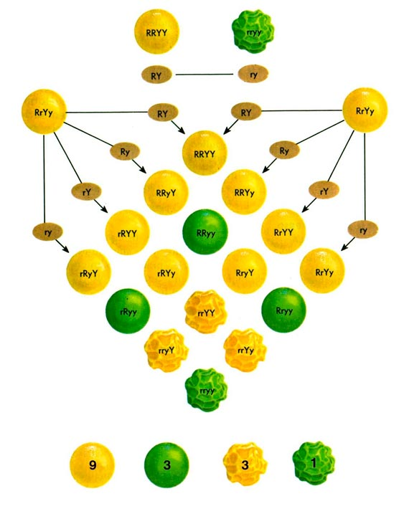
Genetics and Eugenics
1900 - Gregor Mendel’s scientific studies of genetic inheritance (from 1865) are rediscovered and replicated.
1921 – The American Eugenics Society (founded)
(Eugenics is the disturbing proposition to “improve” the human population through selective breeding.)
1928 - Frederick Griffith discovers genetic transformation (dead bacteria can transfer genetic material to "transform" living bacteria).

Slide 17

Entertainment / Media
The public gains increased access to new media leading to booms in advertising and professional sports.
1920 - KDKA Pittsburg begins commercial broadcast radio.
1927 – Warner Bros. releases the first sound-synchronized (talkie) motion picture (The Jazz Singer).
1928 - WRGB (then W2XB) becomes the world's first television station.

Slide 18
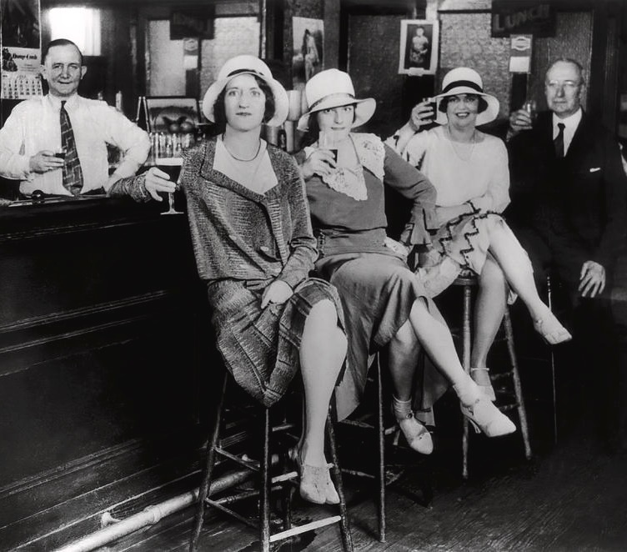
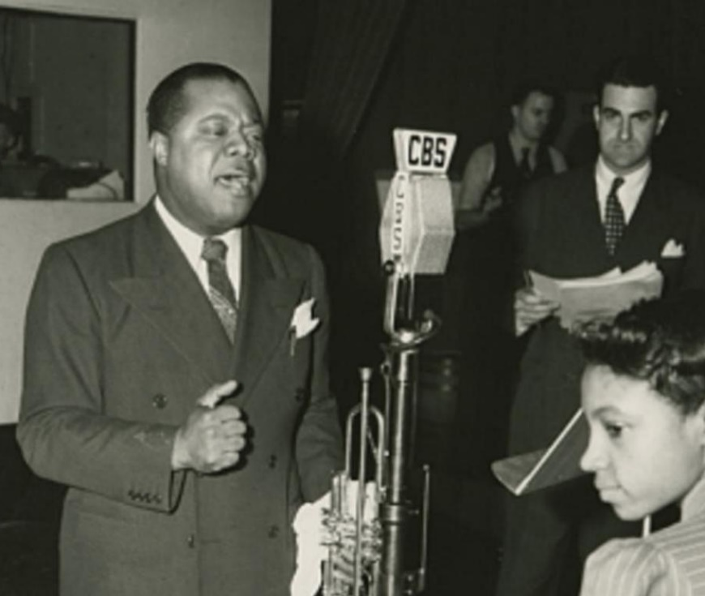
Social Change
The 1920s and 30s saw pivotal changes in Western society.
The Jazz Age / The Roaring 20s
Feminism
Sexual revolution
Prohibition
Consumerism
Urbanization
Harlem Renaissance

Slide 19

Government and World Order
The devastation of WWI and the creation of The League of Nations (1919–1946)
The Russian Revolution (1917) and the rise of Communism
(“Workers of the world, unite!”)
Fascism takes hold
1922 - Benito Mussolini and the National Fascist Party (PNF) take control of Italy.
1929 -The Great Depression spurs the growth of the National Socialist German Workers' Party.

Slide 20
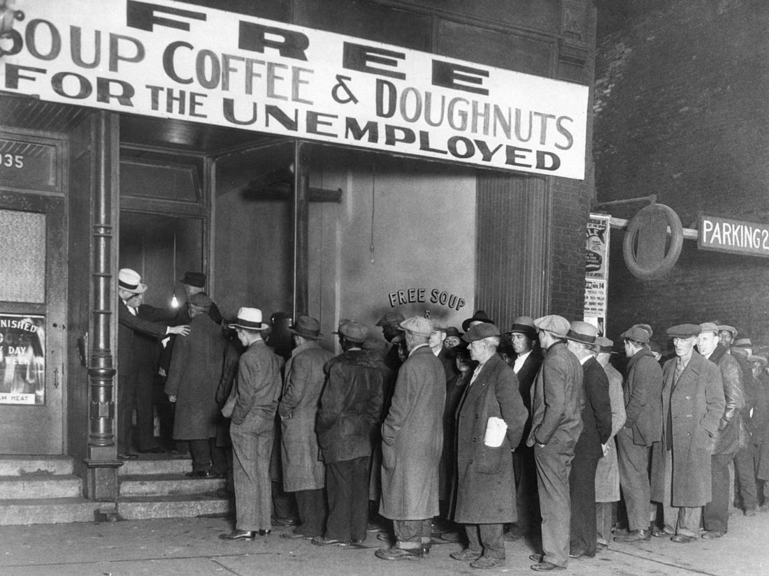
Shattered Optimism
The Great Depression
(1929–1939)
The prosperity and optimism of “The Roaring 20s” came to a screeching halt.
Loss, unemployment, starvation, and instability led many to ask fundamental questions about society, economics, and government.

Slide 21

Criticism of BNW
The implications and themes of Brave New World offended many readers. Some organizations and institutions banned the novel.
“...an unforgiveable offense to progress.” -Wyndham Lewis
“...Aldous Huxley has no right to betray the future as he did in that book.” -H.G. Wells
“...probably casts no light on the future...” -George Orwell
“...as prophecy it is merely fantastic...” -Gerald Bullett

Slide 22
Brave New World
BY ALDOUS HUXLEY
Unit Overview

Slide 23
BNW Unit: Reading Schedule
Reading | Chapters | Due by
1 | 1-3 | _________________
2 | 4-6 | _________________
3 | 7-10 | _________________
4 | 11-14 | _________________
5 | 15-18 | _________________

Slide 24

Main Characters
Bernard Marx: A competent conditioning (brainwashing) expert who struggles to fit in.
Lenina Crowne: An attractive and charismatic young woman. Lenina is a perfect citizen of London society in almost every way.
Helmholtz Watson: An overachiever who feels emptiness in his life despite his success.
John “The Savage”: An outsider from a different culture who moves into the society as an adult.
Mustapha Mond: the Controller; one of the masterminds behind the society.
Brave New World (2020) promotional photo
by Steve Schofield / Peacock

Slide 25
As you read, Watch for…
T
Propaganda
Caste systems
Famous names
Jesus and Bible Stories
Allusions to Shakespeare
Symbolic objects (Have you been paying attention to the Brave New World book covers?)
Community
Identity
Stability

Slide 26

Key Theme Subjects
Stability vs. freedom
Truth vs. happiness
Passion vs. tranquility
Science / technology
Consumerism
Individuality
Sexuality

Slide 27

Unit Goals
Explore the idea of utopia.
Consider Huxley’s speculations.
Trace theme development focusing on elements like characterization, plot structure, and symbolism.
Reach conclusions on how Huxley uses allusions (source materials).
Analyze the author’s style by examining textual evidence.

Slide 28

Connections to Life Today
As you read, think about our lives today. Think about…
Reliance on technology
Consumerism
Promiscuity / sexuality
Genetic engineering
Drugs
Power (and who has it)

Slide 29

Final Task Preview
At the end of the unit, you will write a literary analysis essay on theme development.
Want to give yourself a sneaky advantage? Choose your theme subject in advance and jot down key page numbers as you read.
Individuality
Love / romance
Passion
Freedom / liberty
Scientific and technological advancement
Stability
Consumerism
Truth / knowledge
Happiness / fun

Slide 30
“There's only one corner of the universe you can be certain of improving, and that's your own self.”
- ALDOUS HUXLEY

Slide 31
Copyright 2020 TeachNovels.com

